Slide 1

Crop,Fertilizer and Pesticide Recommendation Using Machine Learning
UNDER THE GUIDANCE OF

Slide 2
Table of contents
×
×
×
×
×
×
×
×
Problem Statement Review of Literature Block Diagram Flowchart Algorithm
Hardware and Software Requirements Conclusion
References

Slide 3
Introduction
×
About 58% of India's population depends on the agricultural sector for their livelihood.
India, along with being the second-largest producer of the world's major food staples like wheat and rice, diverse agriculture-based textile raw materials, coconut, sugarcane, various kinds of dry fruits, and an end number of vegetables and fruits. The agriculture sector plays a crucial role in the development of the country's economy. Precision agriculture i.e., site-specific farming is one of the many techniques brought in to improve the health of the crops and reduce potential environmental risks.
One of the main domains in precision agriculture is the recommendation of crops to crop yield. The suggestion of crops helps in increasing the productivity of crops
increase without the
consumption of too many resources in the process. The main objective of precision farming is profitability and sustainability. It also helps the farmers acquire knowledge to determine the diseases that the crops could get infected by in advance using different methods of precision farming. The inputs given to the model are characteristics of soil, rainfall, humidity, and temperature of the environment. Based on the following parameters provided as the input, the farmer gets suggested the most suitable crop for their field to achieve the maximum crop yield.

Slide 4
Review of Literature
Sr. No | Year | Authors | Paper Title | Description
1 | 2021 | Palaniraj A, | Crop and Fertilizer | This paper includes
 |  | Balamurugan A S, | Recommendation | providing farmers with
 |  | Durga Prasad | System using | crop yield and ratio of
 |  | R,Pradeep P | Machine Learning | fertilizer required
 |  |  |  | based on the
 |  |  |  | parameters of land
 |  |  |  | like atmosphere and
 |  |  |  | soil.
2 | 2020 | Dr.A.K.Mariappan, Ms | Crop Recommendation | In this paper, the
 |  | C. Madhumitha, Ms P. | System through Soil | system uses the K
 |  | Nishitha and Ms S. | Analysis Using | nearest neighbour
 |  | Nivedhitha | Classification in Machine Learning | classification algorithm to improve
 |  |  |  | the efficiency of Crop
 |  |  |  | Recommendation
 |  |  |  | System.

Slide 5
Sr. No | Year | Authors | Paper Title | Description
3 | 2020 | Pradeepa Bandara, | Crop Recommendation | This research provides
 |  | Thilini Weerasooriya, | System | recommendation of a
 |  | Ruchirawya T.H., |  | crop for the selected
 |  | W.J.M. Nanayakkara, |  | land with site-specific
 |  | Dimantha M.A.C and |  | parameters with high
 |  | Pabasara M.G.P |  | accuracy and
 |  |  |  | efficiency using
 |  |  |  | machine learning and
 |  |  |  | artificial intelligence.
4 | 2020 | Pavan Patil, Virendra Panpatil, Prof. Shrikant Kokate | Crop Prediction System using Machine Learning Algorithms | The system helps to test on different crops and gives recommendations of the crops and predicts rainfall using classifier models.

Slide 6
Sr. No | Year | Authors | Paper Title | Description
5 | 2020 | Annapoorna.S, Apoorva Herle, C M Sushma, Neha.Y.Jain, Mr.Vijay Kumar.S | CRAPCSS-Crop Recommendation and Pest Control Suggestion System | This paper proposes a system that uses SVM and Logistics Regression to recommend crops and pest control systems.
6 | 2019 | Bushra Bankotkar, Sudeshna Roy | Recommendation System for Crop Prediction | This paper includes recommendations of crops to the farmers based on the geographical location, soil and weather conditions to help increase yield and grow healthier crops.
7 | 2019 | M.V.R. Vivek, D.V.V.S.S. Sri Harsha, P. Sardar Maran | A Survey on Crop Recommendation Using Machine Learning | In this paper, the model recommends suitable crop based on soil parameters with high specific accuracy, efficiency and crop yield data.

Slide 7
Limitations of Existing System
×
In the existing system, the model used in the following approach is the Support Vector Machine algorithm to determine which crop is better depending on various factors like soil content and atmosphere in that area.
Comparison between different supervised learning algorithms is not done to get the most suitable model for the following system.
×

Slide 8
Problem Statement
×
Productivity needs to be increased so that farmers can get more pay from the same piece of land without degrading soil.
Indian farmers aren’t able to choose the right crop based on their soil requirements depending upon factors like N, P, K, temperature, humidity, rainfall, pH.
Farmers are generally unaware about the organic fertilizers or standard fertilizers to use as per soil requirements.
Due to inadequate and imbalanced fertilization, soil degradation is occurring, which leads to nutrient mining and the development of second-generation problems in nutrient management

Slide 9
Applications
×
Helps inexperienced farmers or farmers with less experience to grow the most suitable crops in order to gain profits and increase crop yield.
Looking at the profits, more number of people would be drawn towards the agricultural sector which helps the growth of the sector.
×

Slide 10
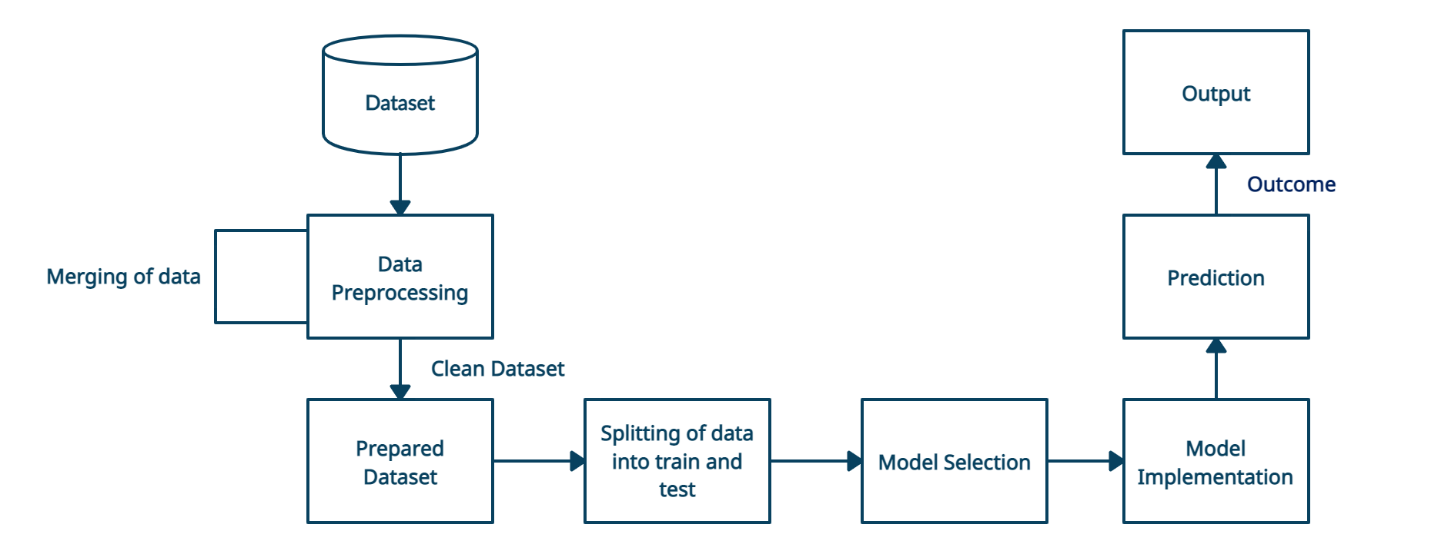
System Architecture

Slide 11
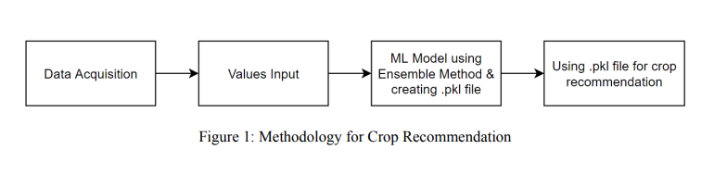
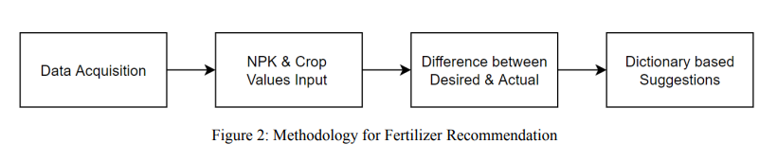
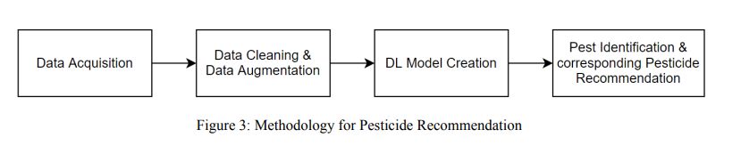
Methodology

Slide 12
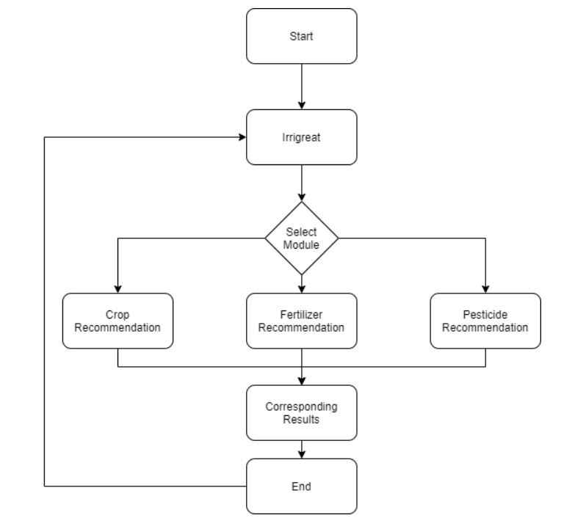
Flowchart

Slide 13
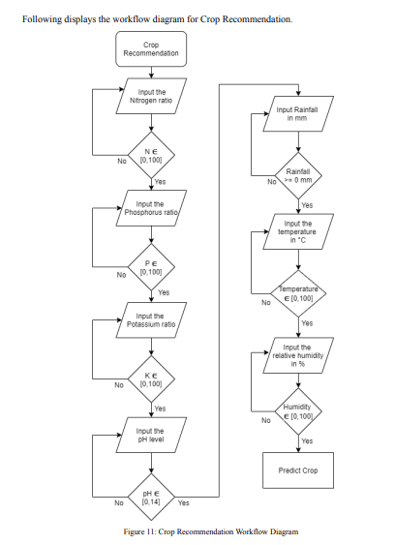
Crop Recommendation Work Flow

Slide 14
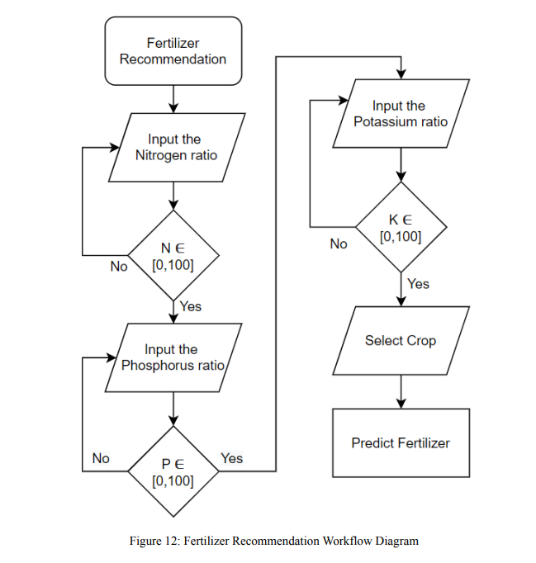
Fertilizer Recommendation Work Flow

Slide 15
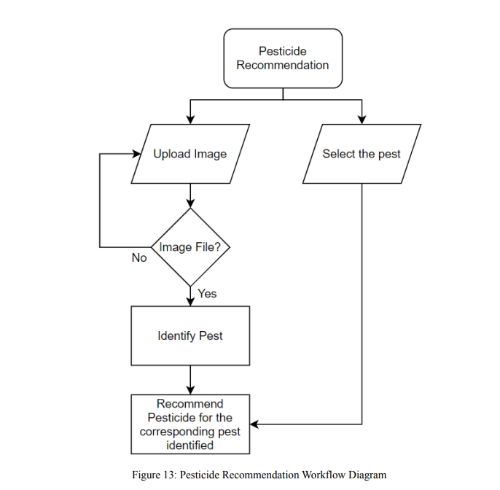
Pesticide Recommendation Work Flow

Slide 16
Hardware and Software Requirements
×
•
•
•
Hardware
Processor (CPU) with 1.1 GHz frequency or above A minimum of 8GB of RAM
Monitor Resolution 1920x1080 or higher
×
•
Operating System
Windows 10
Tools and packages
OpenCV
Numpy, Pandas, Sklearn, matplotlib
×
•
•
•
Language Python 3.8 Html
Css
×
•
Ide
Spyder/Pycharm/Jupyter

Slide 17
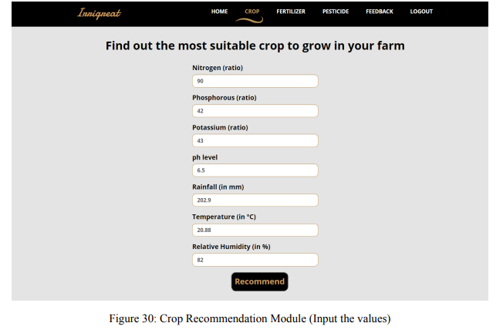

Snapshots

Slide 18
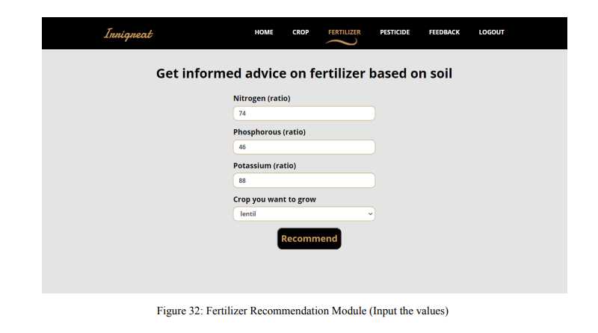
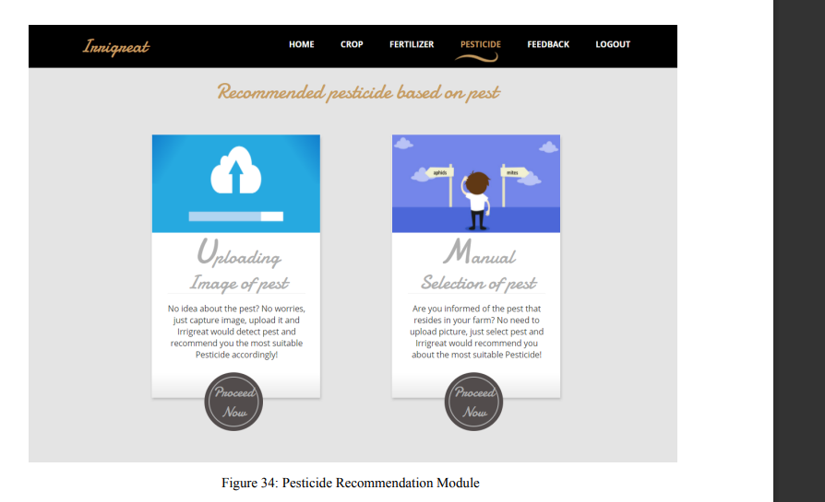
Snapshots

Slide 19
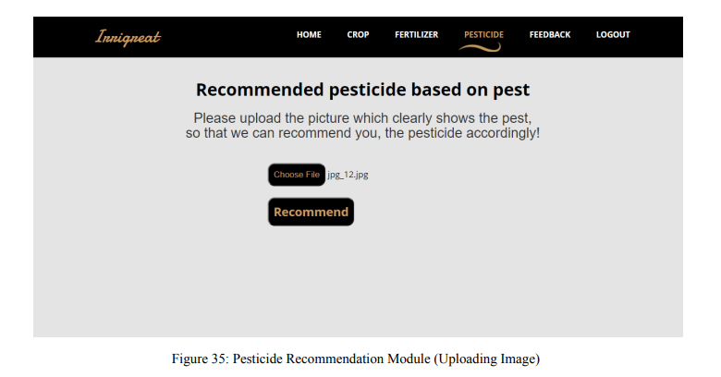
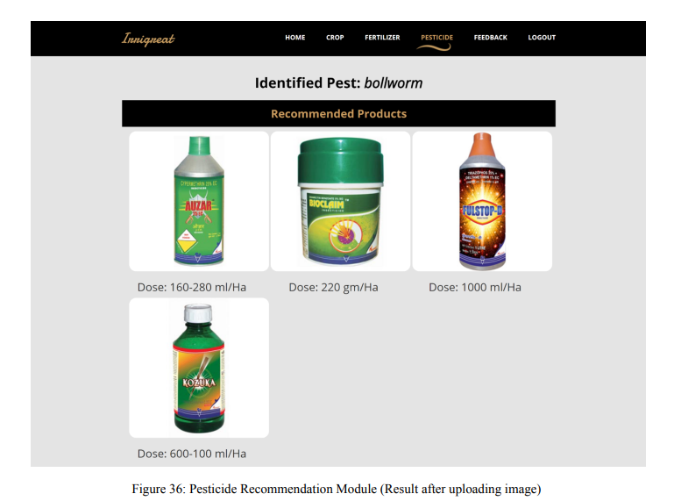
Snapshots

Slide 20
Conclusion
×
The main goal of the Crop Recommendation System is to suggest the right crops based on the different properties of soil and climate conditions like humidity, temperature, and rainfall. This system helps the farmers increase crop yield by growing the recommended crops in the field. The crop and soil data processed into the Supervised Machine Learning Algorithm helps to propose suitable crops. Farmers with less experience can use the following system to learn which crop is better for which type of soil. It also helps them gain a good amount of profit by growing accurate crops. The gain also helps in encouraging more people to join the agricultural sector.

Slide 21
References
×
[1] Palaniraj A, Balamurugan A S, Durga Prasad R,Pradeep P, “Crop and Fertilizer Recommendation System using Machine Learning”, IRJET, Volume 8, April 2021.
×
[2] Dr.A.K.Mariappan, Ms C. Madhumitha, Ms P. Nishitha and Ms S. Nivedhitha, “Crop Recommendation System through Soil Analysis Using Classification in Machine Learning”, IJAST, Volume 29, 2020.
×
[3] Pradeepa Bandara, Thilini Weerasooriya, Ruchirawya T.H., W.J.M. Nanayakkara, Dimantha M.A.C and Pabasara M.G.P, “Crop Recommendation System”, IJCA, Volume 175, October 2020.
×
[4] Pavan Patil, Virendra Panpatil, Prof. Shrikant Kokate, “Crop Prediction System using Machine Learning Algorithms”, IRJET, Volume 7, February 2020.
×
[5] Annapoorna.S, Apoorva Herle, C M Sushma, Neha.Y.Jain, Mr.Vijay Kumar.S, “CRAPCSS - Crop Recommendation and Pest Control Suggestion System”, IRJET, Volume 7, August 2020.
×
[6] Bushra Bankotkar, Sudeshna Roy, “Recommendation System for Crop Prediction”, JCSE, Volume 7, April 2019.
×
[7] M.V.R. Vivek, D.V.V.S.S. Sri Harsha, P. Sardar Maran, “A Survey on Crop Recommendation Using Machine Learning”, IJRTE, Volume 7, February 2019.
×
[8] https://www.ibef.org/industry/agriculture-india.aspx

